Slide 1


DTS 2019
Internet of Things
28 IoT Device Management
digitalent.kominfo.go.id

Slide 2
Topik Bahasan
Overview
Device management
Device management standards
LWM2M

Slide 3
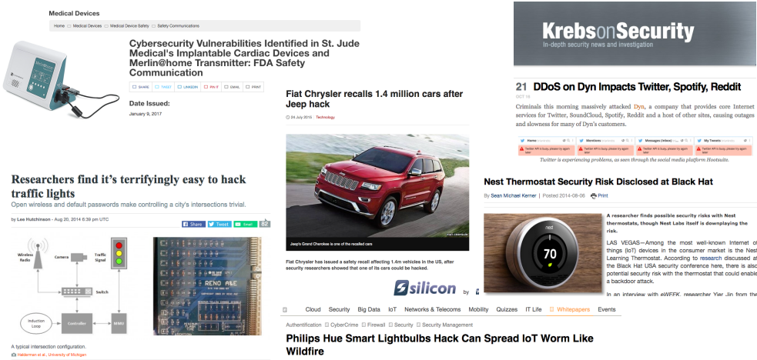
Security – Remote Firmware Update

Slide 4
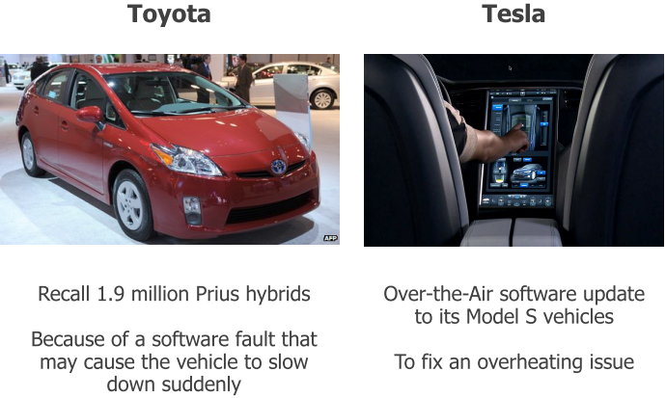
Security – Easy Bug Fixes Update

Slide 5

Remote and Difficult to Access Location

Slide 6
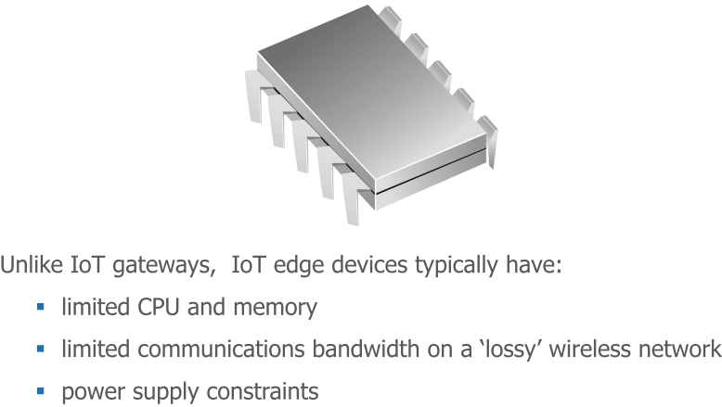
Constrained Devices and Networks

Slide 7
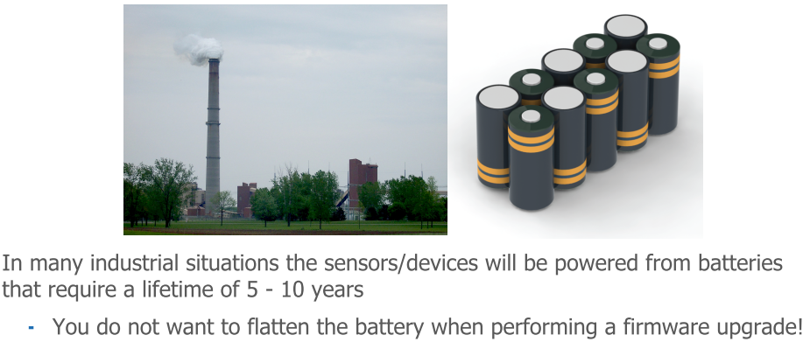
Power Challenges

Slide 8
Device Management
Configure the device
Reboot
Update APN, current date/time, …
Update the firmware / OTA update
Manage the software
Change settings
Access logs
Monitor and gather connectivity statistics

Slide 9
Device Management Standards
TR-069 - Fixed network broadband DSL routers
OMA DM - Mobile phones
SNMP - Enterprise IP networks
OMA LWM2M - IoT constrained devices

Slide 10
LWM2M
LightweightM2M is originally a Device Management technology
Extended to support generic data exchange

Slide 11
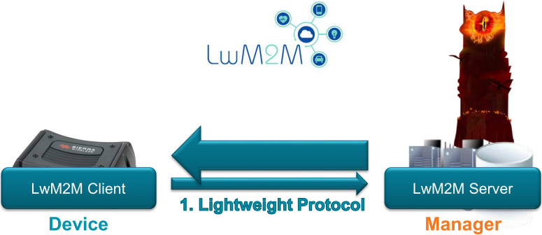

Slide 12
LWM2M
Open Mobile Alliance (OMA) protocol
Designed for Machine to Machine or IoT device management
Communication between LwM2M Server to LwM2M client
Developed for sensor networks
Managing lightweight and low power constrained devices
Based on representational state transfer (REST)
Created for remote management of M2M devices
Enable various IoT services

Slide 13
LWM2M
Secured data transfer – Constrained Application Protocol (CoAP)- IPSO
Based on working group standards from IETF (Internet Engineering task force)
Supported by Eclipse Foundation. Implemented:
Leshan – Java
Wakaama – C

Slide 14
LWM2M Purpose
Provide Device Management functionality over sensor or cellular networks
Transfer service data from the network to devices
Extend to meet the requirements of most any application

Slide 15
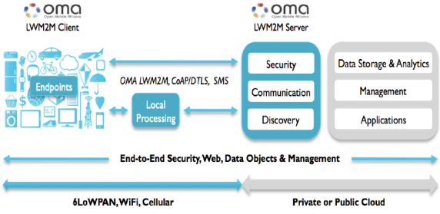
LWM2M Flow Diagram

Slide 16
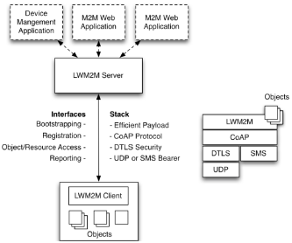

Slide 17
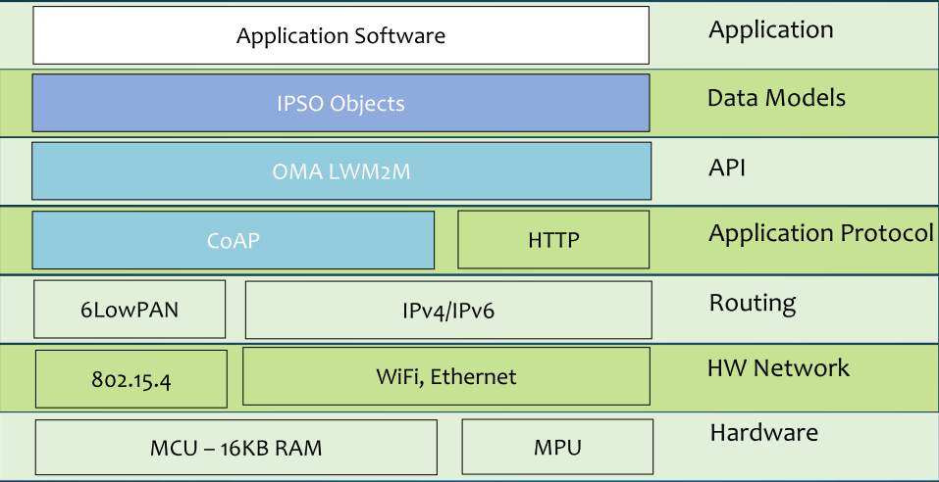
Protocol Layers and IoT Standards

Slide 18
Role of LwM2M Devices in IoT
Designed to create the following opportunities and business benefits for the M2M industry:
Reduce the degree of fragmentation
Enabling more plug-and-play solutions
Act as an enabler to grow the M2M market in various segments ranging from
Smart city
Energy management
Location tracking.
Low cost to enable sustainable business models.

Slide 19
Role of LwM2M Devices in IoT
Improve time-to-market and the manageability of devices
Lead to a decoupling of M2M appliances and server-side platforms, thereby enabling independent innovation of M2M devices and platforms.
Growing the number of interoperable M2M connected devices to provide more choice for M2M customers regarding M2M devices and their management platforms.

Slide 20
Advantages LWM2M Implementation
Reduce the cost
Save the time
Reduce risk
Unlocks the door for new innovations.

Slide 21
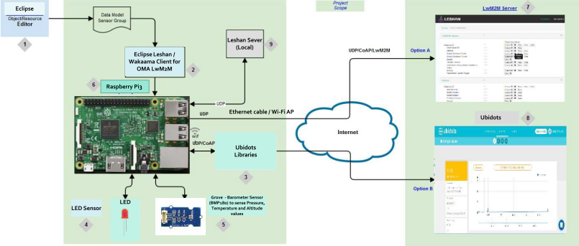
Block Diagram

Slide 22
LWM2M Security
In LWM2M, security is provided by:
Transport layer security (DTLS)
Access control on objects determined per LwM2M Server

Slide 23
LWM2M Features
Firmware upgrade (in band or over HTTP)
Device monitoring and configuration
Server provisioning (bootstraping)

Slide 24
LWM2M: standard objects
Device
Server
Connectivity monitoring
Connectivity statistics
Location
Firmware
LwM2M objects have a numerical identifier
(Device = 3, Location = 6, …)

Slide 25
LWM2M URIs
URLs:
/{object}/{instance}/{resource}
Example:
/6/0 = whole position object (binary TLV)
/6/0/2 = only the altitude value

Slide 26
Praktek
Wakaama
Create object
Configure
Active loop

Slide 27
Wakaama
A C client and server implementation of LwM2M
Not a shared library (.so/.dll)
POSIX compliant and embedded friendly
Plug your own IP stack and DTLS implementation

Slide 28
Features
Register, registration update, deregister
Read, write resources
Read, write, create, delete object instances
TLV or plain text
Observe

Slide 29
Create Object
lwm2m_object_t * get_object_device()
{
lwm2m_object_t * deviceObj;
deviceObj = (lwm2m_object_t *)lwm2m_malloc(sizeof(lwm2m_object_t));
if (NULL != deviceObj)
{
memset(deviceObj, 0, sizeof(lwm2m_object_t));
deviceObj->objID = 3;
deviceObj->readFunc = prv_device_read;
deviceObj->writeFunc = prv_device_write;
deviceObj->executeFunc = prv_device_execute;
deviceObj->userData = lwm2m_malloc(sizeof(device_data_t));
if (NULL != deviceObj->userData)
{
((device_data_t*)deviceObj->userData)->time = 1367491215;
strcpy(((device_data_t*)deviceObj->userData)->time_offset, "+01:00");
}
else
{
lwm2m_free(deviceObj);
deviceObj = NULL;
}
}
return deviceObj;
}

Slide 30
Configure
objArray[0] = get_object_device();
if (NULL == objArray[0])
{
fprintf(stderr, "Failed to create Device object\r\n");
return -1;
}
objArray[1] = get_object_firmware();
if (NULL == objArray[1])
{
fprintf(stderr, "Failed to create Firmware object\r\n");
return -1;
}
objArray[2] = get_test_object();
if (NULL == objArray[2])
{
fprintf(stderr, "Failed to create test object\r\n");
return -1;
}
lwm2mH = lwm2m_init(prv_connect_server, prv_buffer_send, &data);
if (NULL == lwm2mH)
{
fprintf(stderr, "lwm2m_init() failed\r\n");
return -1;
}
result = lwm2m_configure(lwm2mH, "testlwm2mclient", BINDING_U, NULL,
OBJ_COUNT, objArray);
...
result = lwm2m_start(lwm2mH);

Slide 31
Active Loop
while (0 == g_quit)
{
struct timeval tv;
tv.tv_sec = 60;
tv.tv_usec = 0;
/*
* This function does two things:
* - first it does the work needed by liblwm2m (eg. (re)sending some packets).
* - Secondly it adjust the timeout value (default 60s) depending on the
* state of the transaction (eg. retransmission) and the
* time between the next operation
*/
result = lwm2m_step(lwm2mH, &tv);
if (result != 0)
{
fprintf(stderr, "lwm2m_step() failed: 0x%X\r\n", result);
return -1;
}
}

Slide 32
Example
https://github.com/kartben/Wakaama-mbed

Slide 33





IKUTI KAMI
digitalent.kominfo
digitalent.kominfo
DTS_kominfo
Digital Talent Scholarship 2019
Pusat Pengembangan Profesi dan Sertifikasi
Badan Penelitian dan Pengembangan SDM
Kementerian Komunikasi dan Informatika
Jl. Medan Merdeka Barat No. 9
(Gd. Belakang Lt. 4 - 5)
Jakarta Pusat, 10110
digitalent.kominfo.go.id

